Slide 1
AC41004 Team 4
CompareTheHealthcare.com
John Parsons
Sam Glendenning
Victor Yu
Youssef Aloulou
Saif Fardan
Adam Munro
Notes:
Sam

Slide 2
BACKGROUND
Addressing a social need
Contrary to most developed countries, US does not offer universal healthcare for its citizens
“Comparethehealthcare.com” is an online price comparison tool for treatment available to American citizens (location, budget and medicinal needs are taken into account)
Allows to find closest and most affordable treatment all over the country
Promoting health insurance
“Comparethehealthcare.com” highlights the difference between the prices paid for the same treatment by a Medicare-insured citizen and an uninsured citizen
Notes:
Youssef

Slide 3
OUR GOALS
OUR FOCUS
Provide information on a range of affordable healthcare procedures for American citizens of all budgets
Improve public knowledge of healthcare solutions offered to American citizens
Enhance the convenience of medical care for the American citizen
Provide a fast and efficient search of medical procedures offered to the public
Mapping of jargon medical terms to a more accessible vocabulary
Improving public knowledge of healthcare offered in a citizen’s local area
Notes:
Victor – goals
John - focus

Slide 4
APPROACH
Dataset Analysis
Extracting, keyword mapping, formatting, converting
Database Construction
Table design, data importing, procedure creation, view implementation
API Implementation
Database queries, web routes, request testing, logging, unit testing
Web Development
Bootstrap design, search feature, Google Maps API, zip code mapping, paginated results
Notes:
Sam

Slide 5
DEMO
Notes:
John
Adam

Slide 6
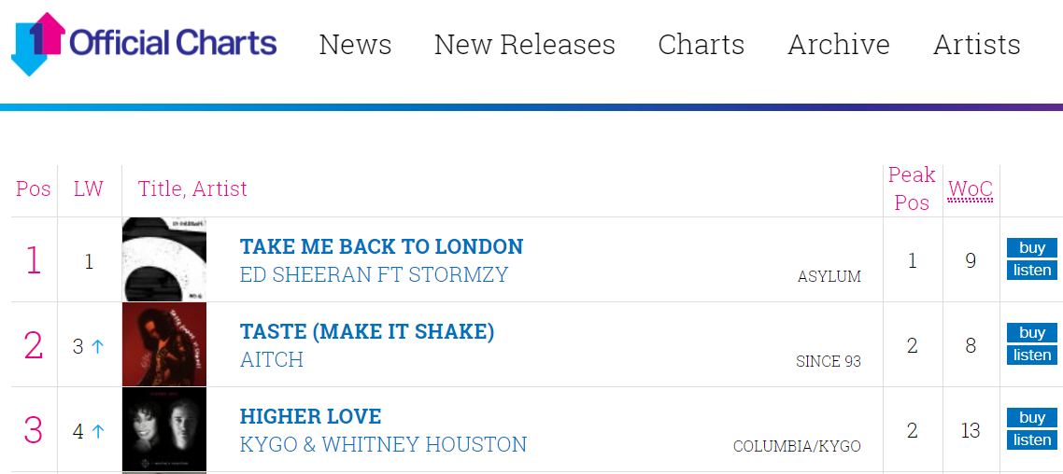



PROBLEMS
of problems
INCONSISTENT DATASET FORMATTING
ADAM MUNRO FT. JOHN PARSONS
3
KEYWORD MAPPING
SAIF FARDAN
3
LONG DATA IMPORT AND QUERY TIMES
EVERYONE HAD TO SUFFER THROUGH THIS
2
Notes:
Adam
Saif

Slide 7
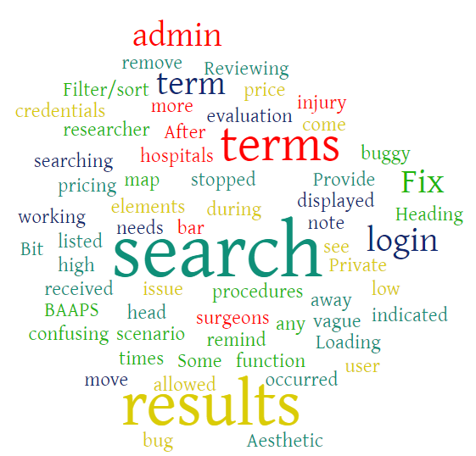
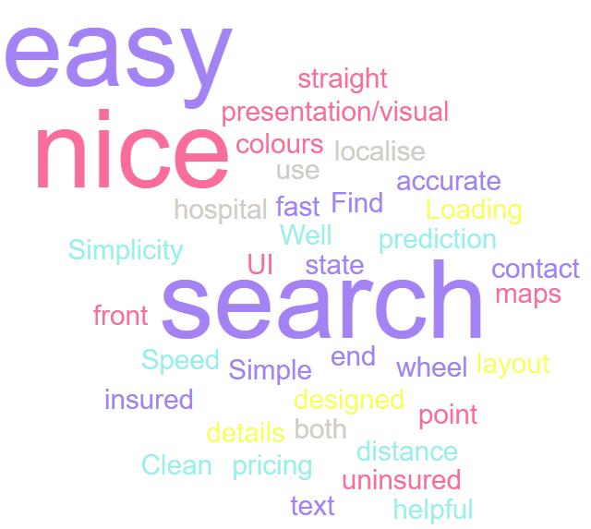
EVALUATIONS & IMPROVEMENTS
Not so good
Good
Notes:
Sam
People liked the presentation and appearance of the website, also believing it is straightforward to use.
However, the results could be confusing and procedure names could be vague, despite our efforts to map keywords.
Both maps highlight the word “search”. People liked the keyword mapping but didn’t think the results of the search were that informative. Mostly the result of lack of useful information about procedures in the dataset.
Also highlight there are more words in the Not so good word map. Indication there was some work required!

Slide 8

CONCLUSION
Team is happy with achievements of project
Applied a rigid agile methodology to our work
Encountered seemingly every problem in the book
Collaborated to overcome them
Went above and beyond to deliver a strong website
Notes:
John

